Slide 1
MELBOURNE or SYDNEY

Slide 2
Problem Statement
The debate over whether Sydney is better than Melbourne is one Australian’s (especially from Melbourne/Sydney) love to debate
So which is better and on what dimensions?
Set out to explore both Melbourne & Sydney City councils to compare (probably unfair, both have amazing locations outside these boundaries)
Use foursquare venue data augmented with ABS statistics to segment/cluster neighborhoods to describe/explore each city
Combine and find like neighbourhoods
Compare limited set of cafes, bars and restaurants and their rating

Slide 3
Point of comparison: Sydney vs. Melbourne

Slide 4
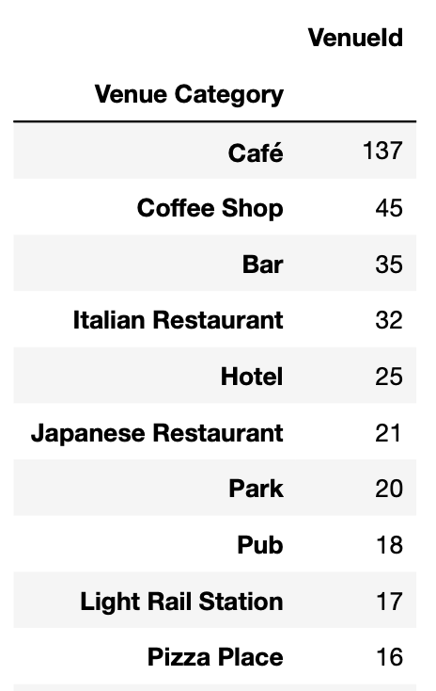
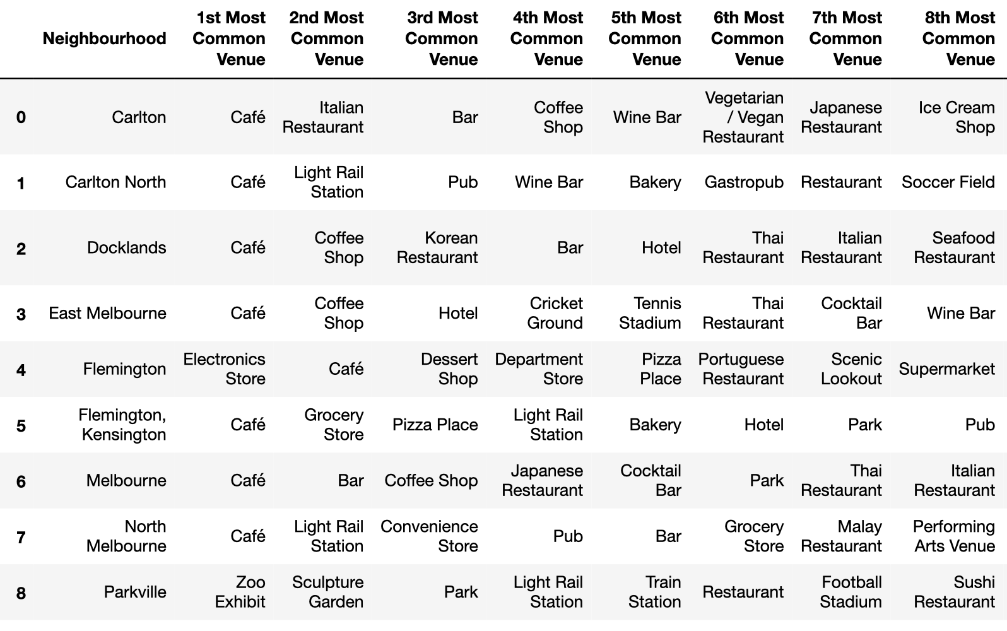
Venues (Melbourne)

Slide 5
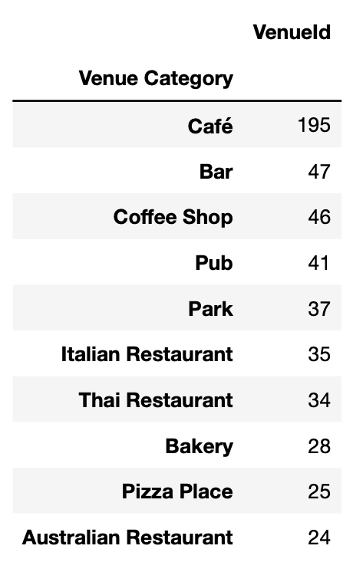
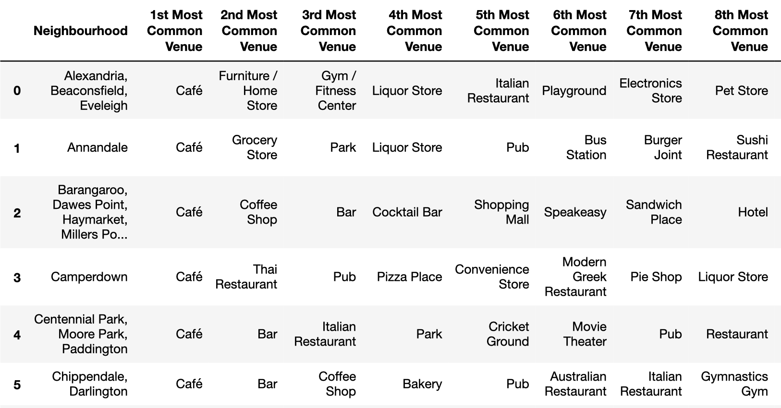
Venues (Sydney)

Slide 6
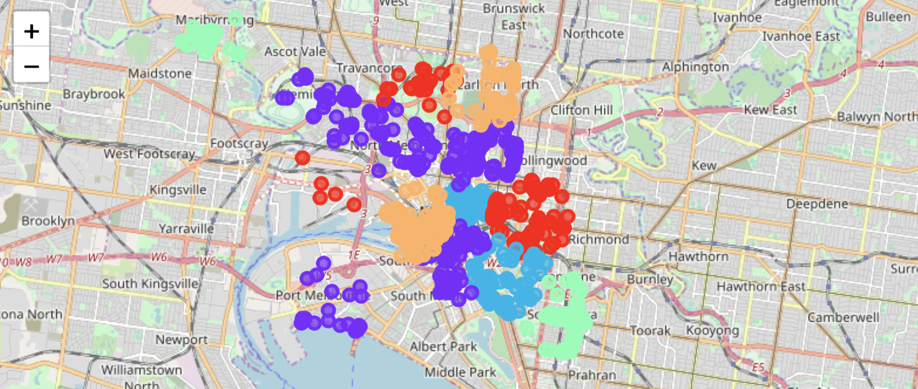
Neighbourhoods & Clusters/Segments
Melbourne

Slide 7
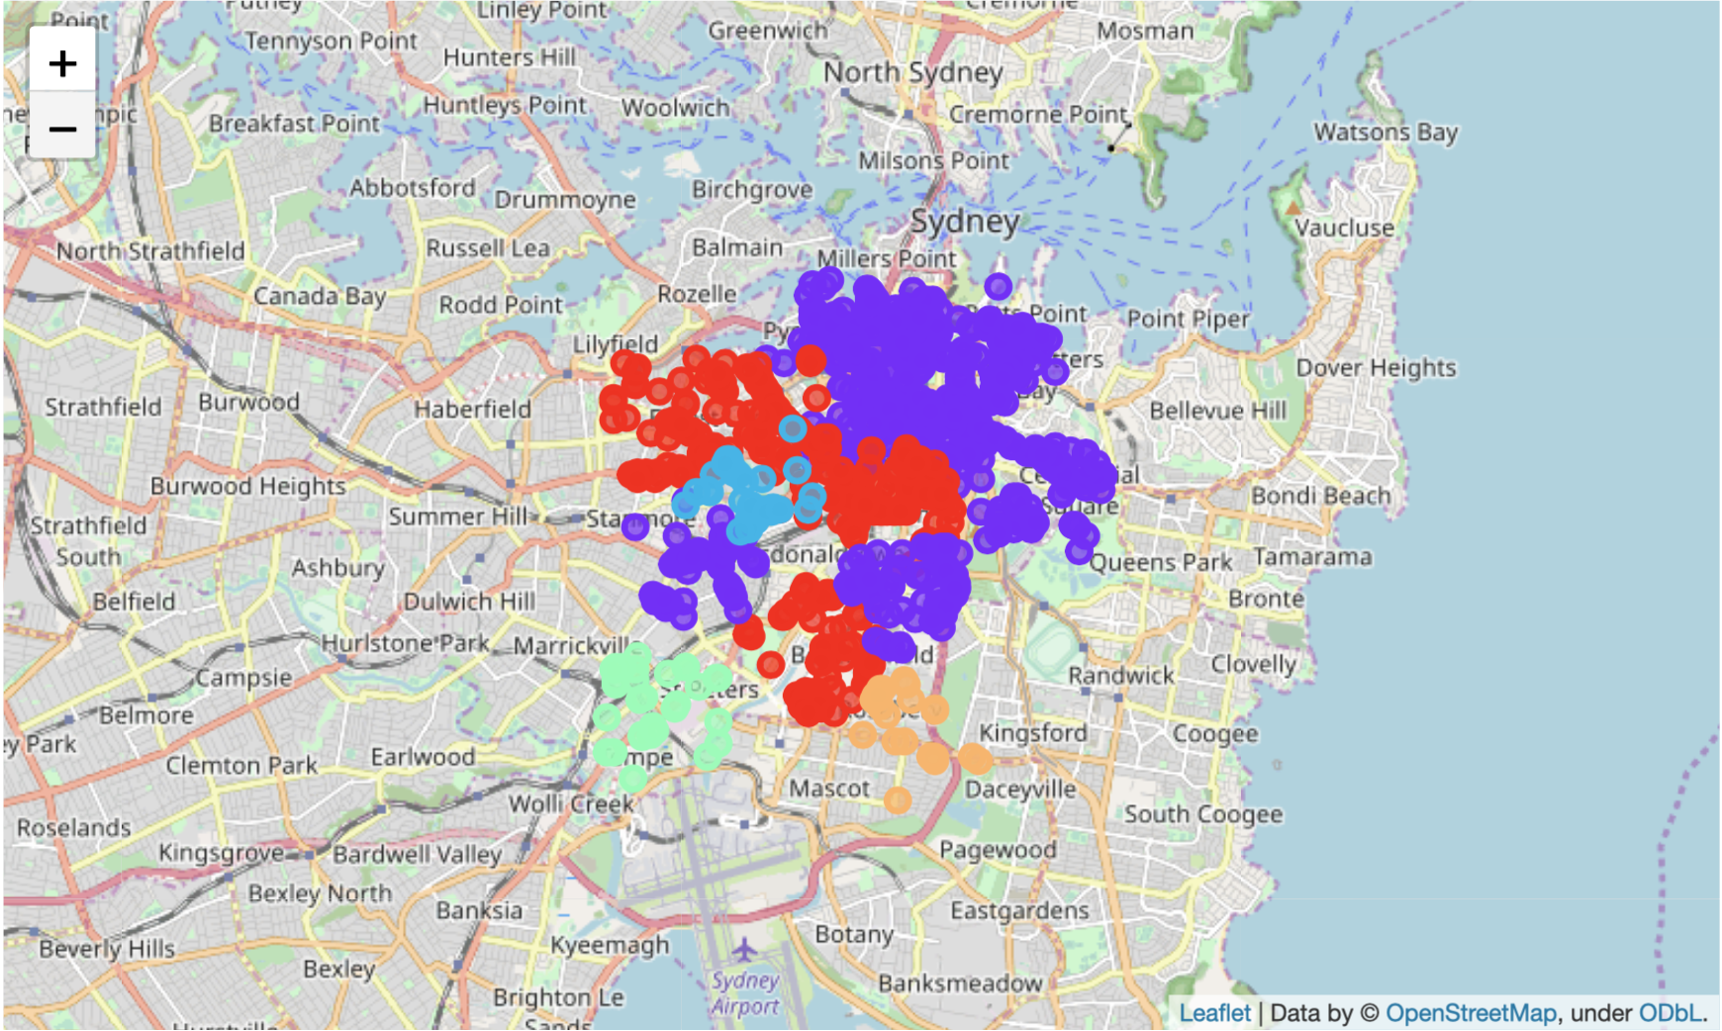
Neighbourhoods & Clusters/Segments
Sydney

Slide 8
Cafes

Slide 9
Bars

Slide 10
Restaurants

Slide 11
Summary

Slide 12
Limitations, assumptions, excuses
Assumed that Sydney/Melbourne city council zones were appropriate for comparison. Both miss key parts that people would normally consider essential parts of each city, but had to limit the analysis in some way.
Foursquare venues listed in Australian seem somewhat limited, compared with the volume listed with google. Also, tourist volumes to each city may vary resulting in biases within each data set.
Google unfortunately limits venue search to 60 (over multiple pages)
I was able to manually move around the CBD (or part of to do a quick comparison but ultimately ran out of time to do more)
Would have been great to add some additional data from open data sources available. Ultimately this because a timely exercise of looking for data and thinking about how it could be used.
Probably need to provide some normalization of the neighbourhood statistics

